Slide 1
CLASSIFYING KIDNEY DISEASE WITH AI REVOLUTIONARY APROACH TO EARLY DETECTION

Slide 2
Abstract
Early prediction of kidney disease is crucial for effective treatment and management. This project focuses on leveraging Artificial Intelligence (AI) to classify and detect kidney diseases at an early stage. By integrating data preprocessing, visualization, and machine learning algorithms with the Django framework, the system aims to enhance diagnostic accuracy and healthcare workflows. The project involves preprocessing patient data to ensure quality and consistency, followed by visualizing the data to uncover patterns and insights. Advanced machine learning algorithms, such as employed to classify kidney diseases based on medical imaging and patient records. The Django framework serves as the backbone for developing a user-friendly interface, allowing healthcare professionals to interact with the system efficiently. This approach not only improves early detection but also supports informed decision-making in patient care.
Keywords: Kidney Disease Classification, Artificial Intelligence, Early Detection, Data Preprocessing, Data Visualization, Machine Learning Algorithms, Django Framework, Healthcare Analytics.

Slide 3
EXISTING SYSTEM
Histotripsy is a focused ultrasound therapy that ablates tissue via the action of bubble clouds. It is under investigation to treat a number of ailments, including renal tumors. Ultrasound imaging is used to monitor histotripsy, though there remains a lack of definitive imaging metrics to confirm successful treatment outcomes. In this study, a convolutional neural network (CNN) was developed to segment ablation on ultrasound images. Methods: A transfer learning approach was used to replace classification layers of the residual network ResNet-18. Inputs to the classification layers were based on ultrasound images of ablated red blood cell phantoms. Digital photographs served as the ground truth. The efficacy of the CNN was compared to subtraction imaging, and manual segmentation of images by two board-certified radiologists. Results: The CNN had a similar performance to manual segmentation, though was improved relative to segmentation with subtraction imaging. Predictions of the network improved over the course of treatment, with the Dice similarity coefficient less than 20% for fewer than 500 applied pulses, but 85% for more than 750 applied pulses. The network was also applied to ultrasound images of ex vivo kidney exposed to histotripsy, which indicated a morphological shift in the treatment profile relative to the phantoms. These findings were consistent with histology that confirmed ablation of the targeted tissue. Conclusion: Overall, the CNN showed promise as a rapid means to assess outcomes of histotripsy and automate treatment. Significance: Data collected in this study indicate integration of CNN image segmentation to gauge outcomes for histotripsy ablation holds promise for automating treatment procedures.

Slide 4
Drawbacks
• Limited Generalization: The CNN was trained on ablated red blood cell phantoms, which may not fully represent the variability in real renal tumors, potentially limiting the model's generalizability.
• Dependency on Image Quality: The effectiveness of the CNN might be compromised by variations in ultrasound image quality or artifacts, impacting its accuracy in different clinical settings.
• Interpretation of Morphological Shifts: While the CNN showed a morphological shift in the treatment profile, interpreting these changes might require additional validation and could be subject to inconsistencies between phantoms and actual tissue.

Slide 5
Proposed System:
To revolutionize the early prediction of kidney disease using AI, the proposed system will integrate several key components. First, it will implement advanced preprocessing techniques to clean and normalize medical data, ensuring high-quality input for machine learning algorithms. This will be followed by sophisticated data visualization tools to provide intuitive insights into patient data and disease patterns. Cutting-edge machine learning algorithms, ensemble methods, will be employed to enhance the accuracy and efficiency of disease classification. Finally, the Django framework will serve as the backbone for the system, facilitating integration of the preprocessing, visualization, and algorithmic components through a user-friendly web interface that enables predictions and interactive data exploration.

Slide 6
ADVANTAGES:
• Enhanced Accuracy: Advanced preprocessing and ensemble machine learning algorithms improve the precision of disease classification, leading to more reliable early predictions.
• Intuitive Insights: Sophisticated data visualization tools make it easier for healthcare professionals to understand patient data and disease patterns, facilitating better decision-making.
• Seamless Integration: The Django framework provides a user-friendly web interface, integrating all components efficiently and allowing for interactive data exploration and predictions.

Slide 7
LITERATURE SURVEY
Title : A study of the visualization of artificial intelligence applications in chronic kidney disease in the literature over the last 20 years .
Author: Yudi Li, Ying Ding, Yan Xu , Haoji Meng , Hongji Wu, Donglin Li, Yibo Hu.
Year : 2024
Chronic kidney disease (CKD) is a global public health problem characterized by persistent kidney damage or loss of kidney function. Previously, the diagnosis of CKD has mainly relied on serum creatinine and estimation of the glomerular filtration rate. However, with the development and progress of artificial intelligence (AI), AI has played different roles in various fields, such as early diagnosis, progression prediction, prediction of associated risk factors, and drug safety and efficacy evaluation. Therefore, research related to the application of AI in the field of CKD has become a hot topic at present. Therefore, this study adopts a bibliometric approach to study and analyze the development and evolution patterns and research hotspots of AI-CKD. English publications related to the field between January 1, 2004, and June 27, 2024, were extracted from the Web of Science Core Collection database. The research hotspots and trends of AI-CKD were analyzed at multiple levels, including publication trends, authors, institutions, countries, references and keywords, using VOSviewer and CiteSpace. The results showed that a total of 203 publications on AI-CKD were included in the study, of which Barbieri Carlo from the University of Milan, Italy, had the highest number of publications (NP=5) and had a high academic impact (H-Index=5), while the USA and its institution, the Mayo Clinic, were the publications. The USA and its Mayo Clinic are the countries and institutions with the highest number of publications, and China is the country with the second highest number of publications, with three institutions attributed to China among the top five institutions. Germany's institution, Fresenius Medical Care, has the highest academic impact (H-index=6). Keyword analysis yielded artificial intelligence, chronic kidney disease, machine learning, prediction model, risk, deep learning, and other keywords with high frequency, and cluster analysis based on the timeline yielded a total of 8 machine learning, deep learning, retinal microvascular abnormality, renal failure, Bayesian network, anemia, bone disease, and allograft nephropathology clusters. This study provides a comprehensive overview of the current state of research and global frontiers of AI-CKD through bibliometric analysis. These findings can provide a valuable reference and guidance for researchers.

Slide 8
LITERATURE SURVEY
Title : Chronic Kidney Disease Prediction Using Machine Learning.
Author: hrinidhI.
Year : 2023
Millions of people worldwide are afflicted with the degenerative condition known as chronic kidney disease (CKD). Improved patient outcomes and the prevention of future renal damage are possible with early detection of CKD. In this work, CKD was predicted using patient data using machine learning (ML) methods. Data from patients with CKD were included in the dataset for this investigation, including demographic, clinical, and laboratory information. In order to predict CKD, four ML algorithms—Naive Bayes, Decision Trees, K-Nearest Neighbours (KNNs), and Neural Networks—were applied. The study's findings demonstrated that all four machine learning algorithms were highly accurate at predicting CKD. With an AUC of 0.92, Neural Networks had the highest accuracy, followed by Decision Trees, KNNs, Naive Bayes, and KNNs with AUCs of 0.87, 0.85, 0.85, and 0.85, respectively. The study underscores the value of early detection for better patient outcomes and shows the potential of ML algorithms to predict CKD.

Slide 9
LITERATURE SURVEY
Title: Chronic Kidney Disease Prediction Using Machine Learning.
Author: Chamandeep Kaur , M. Sunil Kumar , Afsana Anjum , M. B. Binda , Maheswara Reddy Mallu .
Year : 2023
The occurrence of Chronic Renal Disease (CRD), is also referred to as Chronic Kidney Disease (CKD). It depicts a medical condition that harms the kidneys and has an impact on a person’s overall health. End-stage renal disease and the patient’s eventual mortality can result from improper disease diagnosis and treatment. In the field of medical science, Machine Learning (ML) techniques have become a valuable tool and play a significant role in disease prediction. The development and validation of a predictive model for the prognosis of chronic renal disease is the aim of the proposed study. A dataset on chronic kidney disease with 400 samples was taken from the UCI Machine Learning Repository. Three machine learning classifiers— Logistic Regression (LR), Decision Tree (DT), and Support Vector Machine (SVM)—were used for analysis, and the bagging ensemble method was used to enhance the model’s performance. The machine learning classifiers were trained using the clusters of the dataset for chronic renal disease. The Kidney Disease Collection is then compiled using nonlinear features and categories. The decision tree produces the best results, with an accuracy of 95%. Finally, we achieve the greatest accuracy of 97% by using the bagging ensemble approach.

Slide 10
LITERATURE SURVEY
Title: Predicting Chronic Kidney Disease using ML algorithms and XAI
Author: Sudip Raj Khadka, Saphal Subedi, Bikash Kumar Aidy, Lok Nath Regmi, Ashish Parajuli and Mohan Bhandari.
Year : 2023
Kidney disease is a significant health concern that is currently affecting individuals of all age groups. To predict the occurrence of chronic renal disease, a large number of scholars have employed machine learning and deep learning techniques. However, the efficacy of these methods is often hampered by a lack of transparency, which is a major issue in the application of artificial intelligence in healthcare and medical analysis. As such, the lack of clarity has prompted concern. To interpret the results of predictive models, the present study proposes the deployment of four machine learning algorithms, including Decision Tree, Logistic Regression, Multi-layer Perceptron Classifier, and Support Vector Machine, in combination with explainable AI (XAI) interface, leveraging the local interpretable model-agnostic explanation (LIME) and shapely additive explanation shapely additive values (SHAP). The proposed models are intended to facilitate effective decision-making in clinical research and therapeutic practices

Slide 11
LITERATURE SURVEY
Title: Role of Artificial Intelligence in Kidney Disease.
Author: Qiongjing Yuan, Haixia Zhang, Tianci Deng, Shumei Tang, Xiangning Yuan, Wenbin Tang.
Year : 2020
Artificial intelligence (AI), as an advanced science technology, has been widely used in medical fields to promote medical development, mainly applied to early detections, disease diagnoses, and management. Owing to the huge number of patients, kidney disease remains a global health problem. Challenges remain in its diagnosis and treatment. AI could take individual conditions into account, produce suitable decisions and promise to make great strides in kidney disease management. Here, we review the current studies of AI applications in kidney disease in alerting systems, diagnostic assistance, guiding treatment and evaluating prognosis. Although the number of studies related to AI applications in kidney disease is small, the potential of AI in the management of kidney disease is well recognized by clinicians; AI will greatly enhance clinicians’ capacity in their clinical practice in the future.

Slide 12
SYSTEM STUDY:
Aim
The aim is to develop an advanced AI system for early kidney disease detection by leveraging cutting-edge machine learning techniques. This approach seeks to enhance diagnostic accuracy and efficiency by analyzing medical images and clinical data. The goal is to enable timely and precise identification of kidney abnormalities, improving patient outcomes and facilitating proactive healthcare interventions.
Objectives
Develop an AI-driven system for the early and accurate classification of kidney diseases using advanced machine learning techniques. Enhance diagnostic precision by integrating medical imaging and clinical data for comprehensive disease analysis. Implement real-time analysis capabilities to facilitate timely intervention and personalized treatment plans. Ensure the system is scalable and adaptable to various healthcare environments, improving patient outcomes and healthcare efficiency..

Slide 13
SYSTEM STUDY
Problem Description/ Problem Statements
Despite advances in medical technology, the early detection and accurate classification of kidney diseases remain significant challenges in healthcare. Traditional diagnostic methods often rely on subjective interpretations of medical images and clinical data, which can lead to delayed diagnoses and suboptimal patient outcomes. There is a pressing need for an innovative approach that leverages artificial intelligence (AI) to enhance the precision and timeliness of kidney disease detection. By employing AI-driven techniques, such as Convolutional Neural Networks (CNNs) and advanced data analytics, this project aims to develop a revolutionary system that can automatically analyze medical images and clinical records to detect kidney abnormalities at an early stage. The goal is to improve diagnostic accuracy, streamline the detection process, and ultimately lead to better management and treatment of kidney diseases, thereby addressing a critical gap in current healthcare practices.

Slide 14
SYSTEM STUDY
Scope
The project on "Classifying Kidney Disease with AI: Revolutionary Approach to Early Detection" aims to harness the power of artificial intelligence to transform the early detection and classification of kidney diseases. By integrating advanced AI techniques such as Convolutional Neural Networks (CNNs) for medical imaging and machine learning algorithms for clinical and genetic data analysis, this project seeks to create a comprehensive and highly accurate diagnostic tool. The scope includes developing a robust AI model capable of analyzing various forms of medical imaging—such as ultrasound, CT scans, and MRIs—alongside clinical data to identify and classify kidney conditions at an early stage. The project will involve the collection and preprocessing of diverse datasets, training and validating the model, and deploying it within clinical settings to assist healthcare professionals in making more informed decisions. Additionally, the project addresses ethical considerations, including data privacy and fairness, ensuring that the AI system is both effective and equitable. Ultimately, this innovative approach aims to significantly enhance early diagnosis, improve patient outcomes, and set new standards in kidney disease management.

Slide 15
by tuned time to time with improving the accuracy.
Construction of a Predictive Model
Data Gathering
Data Pre-Processing
Choose model
Train model
Test model
Tune model
Prediction

Slide 16
Environmental Requirements
1. Software Requirements:
Operating System : Windows
Tool : Anaconda with Jupyter Notebook
2. Hardware requirements:
Processor : Pentium IV/III
Hard disk : minimum 80 GB
RAM : minimum 2 GB

Slide 17
SOFTWARE DESCRIPTION
The software for classifying kidney disease using an AI-driven approach represents a groundbreaking advancement in early medical diagnostics. This innovative solution leverages cutting-edge artificial intelligence techniques, particularly deep learning algorithms, to analyze medical imaging and clinical data with exceptional precision. By integrating Convolutional Neural Networks (CNNs) for image analysis and advanced machine learning models for clinical data, the software can accurately identify and classify various stages of kidney disease from images such as ultrasound, CT scans, or MRIs. It processes vast amounts of data, including patient demographics, lab results, and medical history, to provide early and reliable detection of kidney abnormalities. The system's ability to continuously learn and adapt from new data ensures that it remains at the forefront of diagnostic accuracy. With an intuitive user interface designed for healthcare professionals, this software enhances decision-making, streamlines diagnostic workflows, and ultimately contributes to better patient outcomes through timely and precise interventions.

Slide 18
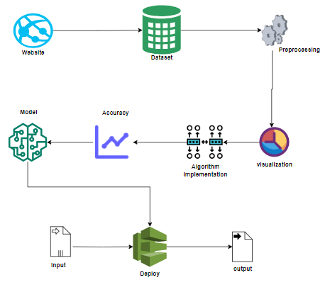
Business diagram/System Architecture

Slide 19
Work flow diagram
Source Data
Data Processing and Cleaning
Training Dataset
Testing Dataset
Classification ML Algorithms
Best Model by Accuracy
Finding Kidney Disease

Slide 20
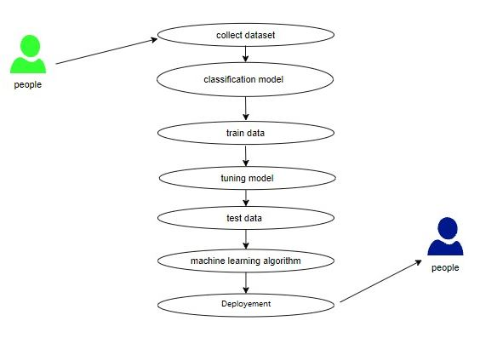
Usecase diagram

Slide 21
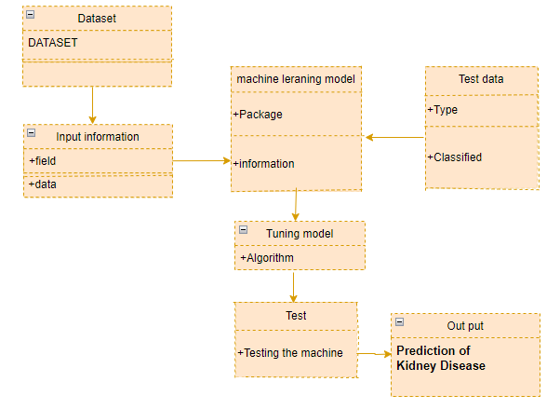
Class Diagram:

Slide 22
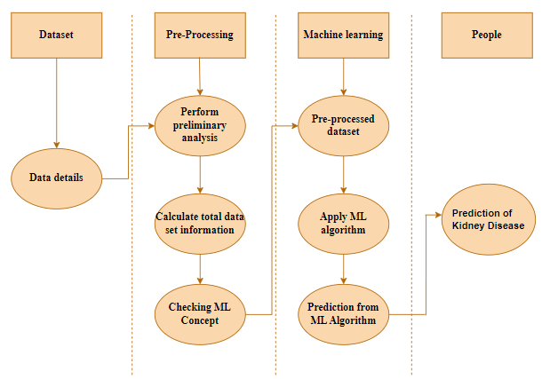
Activity Diagram

Slide 23
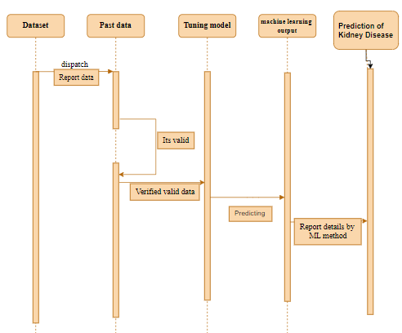
Sequence Diagram:

Slide 24
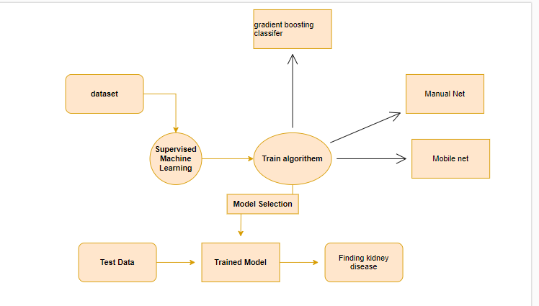
Entity Relationship Diagram (ERD)

Slide 25
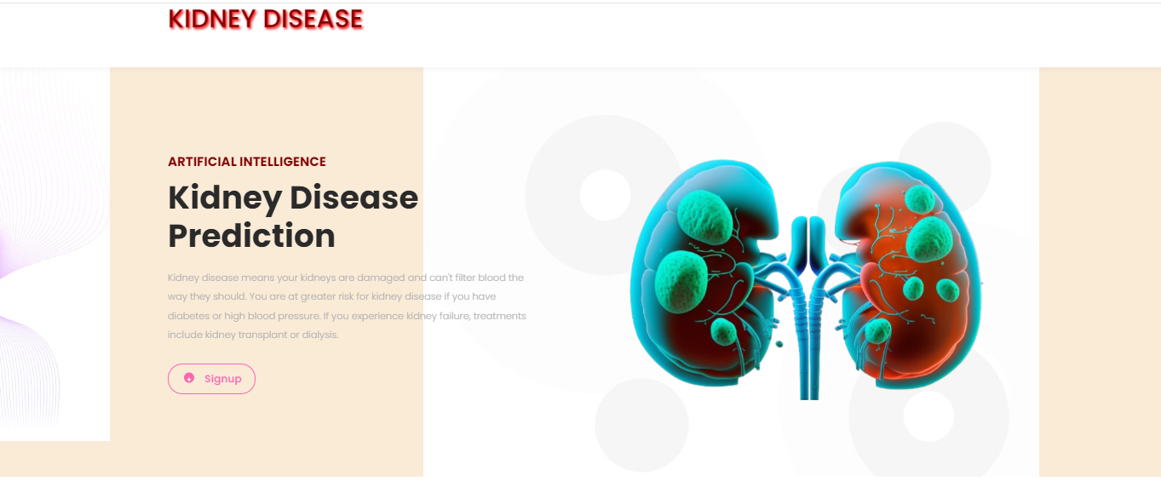
OUTPUT SCREENHSOT:

Slide 26

OUTPUT SCREENHSOT:

Slide 27

OUTPUT SCREENHSOT:

Slide 28
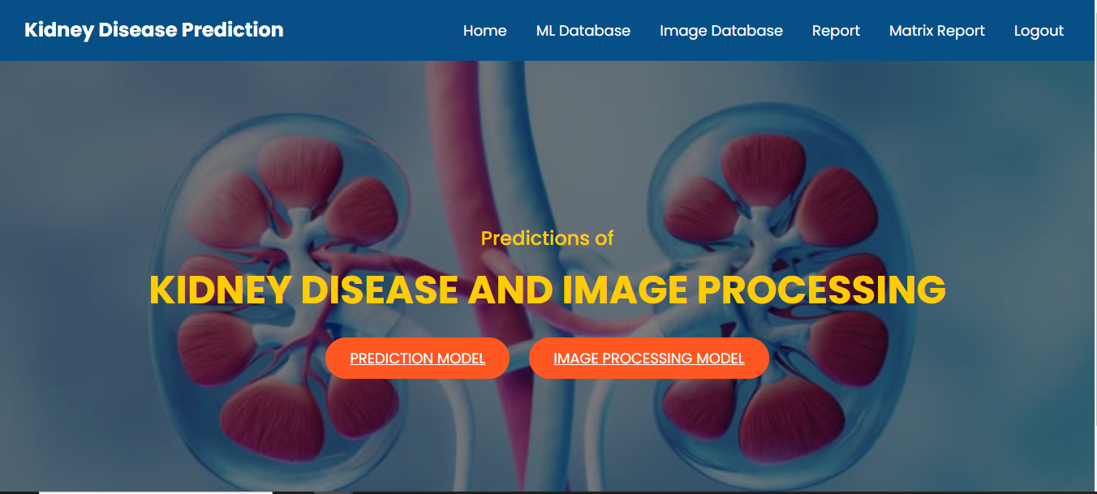
OUTPUT SCREENHSOT:

Slide 29
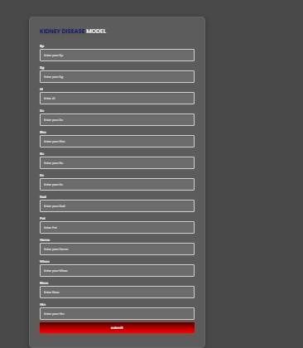
OUTPUT SCREENHSOT:

Slide 30
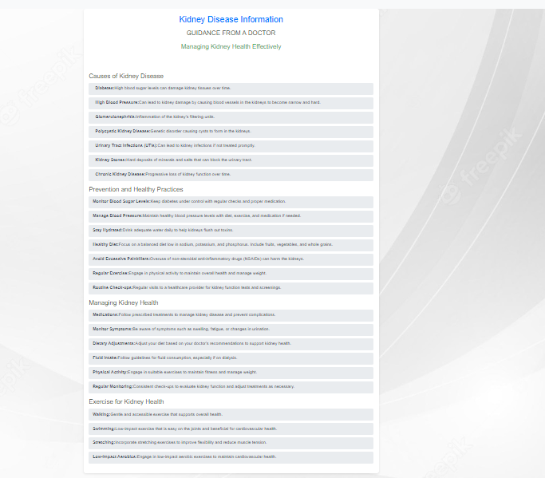
OUTPUT SCREENHSOT:

Slide 31
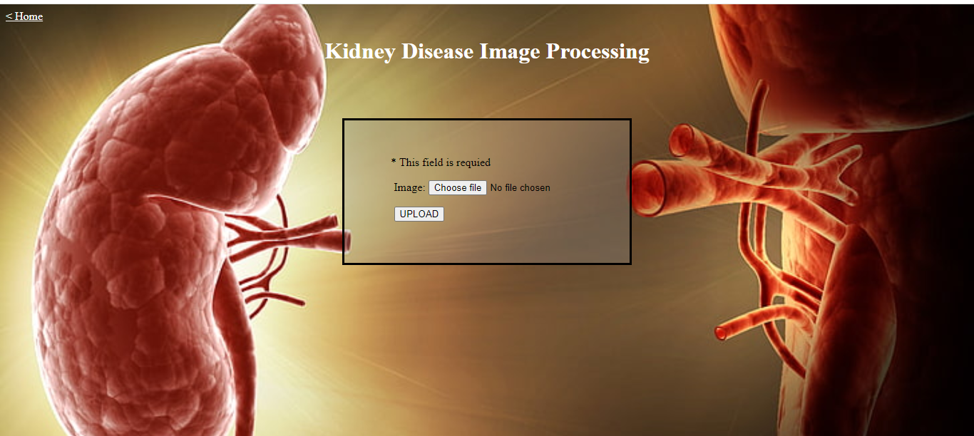
OUTPUT SCREENHSOT:

Slide 32

OUTPUT SCREENHSOT:

Slide 33
conclusion
In conclusion, the integration of AI into kidney disease classification represents a revolutionary approach to early detection and diagnosis. By leveraging advanced machine learning techniques such as Convolutional Neural Networks (CNNs) and sophisticated data processing methods, this approach significantly enhances the accuracy and efficiency of identifying kidney abnormalities. The AI-powered system not only improves diagnostic precision by analyzing medical images and clinical data but also enables early intervention, which is crucial for better patient outcomes. With continuous advancements in AI technology and data collection, this methodology promises to transform kidney disease management, making it possible to detect conditions at their earliest stages and thereby improve treatment efficacy and patient quality of life.

Slide 34
Futurework
To automate this process by show the prediction result in web application or desktop application.
We can deploy this model in any cloud based system.

